Slide 1
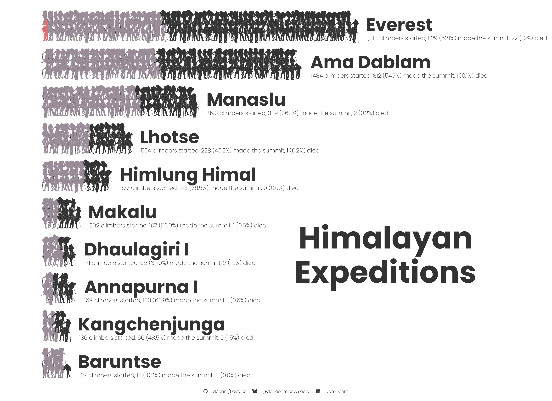



Climbers who made the summit
Climbers who didn’t make the summit
Climbers who died on the expedition
For all expeditions from 2021-2024. Each image represents 10 climbers
Notes:
Sam has received 34 confessionals, 9 more than expected

